Slide 1






Health Insurance Claims Presentation
MATHABATHE Paballo Phakoe
Notes:
---

Slide 2

Health Insurance Claims Overview
Stage 1
Notes:
Executive Summary, Claim Status Distribution Overview, Specialty Claims Insight, Monthly Claim Patterns, Yearly Claim Trends

Slide 3
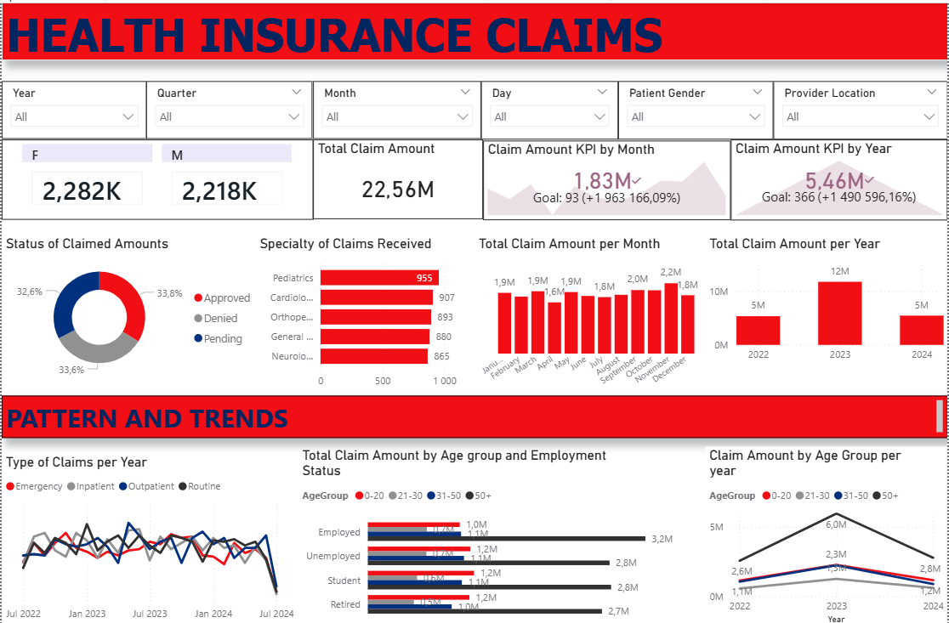
Health Insurance Claims dashboard overview

Slide 4




Interactive filters (Slicers) and KPIs overview
Slicers allows the team to dynamically explore the data by Year, Quarter, Month, Day, Patient Gender, and Provider Location.
Changing a filter automatically updates all visuals, enabling deeper insights and flexible analysis
Monthly Claim KPI: Displays the current month’s claim amount, trend over previous months, and comparison against a monthly goal.
Yearly Claim KPI: Shows yearly claim amount, long‑term trend, and performance against yearly goals

Slide 5



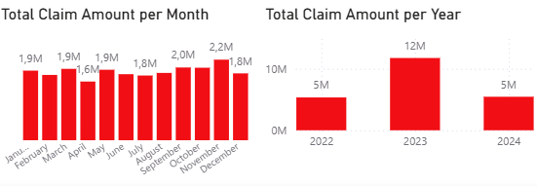
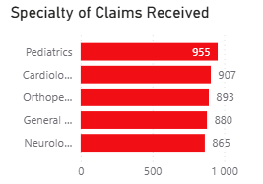

Executive Summary
Total Claim Amount
  Total claims reached approximately 22.56 million, indicating strong activity across demographics and clinical segments.
  Gender Distribution
  Male and female claimants are nearly equal, showing no significant gender skew in claim submissions.
  Seasonal Claim Trends
  Claim amounts fluctuate monthly and annually, reflecting seasonal healthcare utilisation patterns.
  Top Medical Specialties
  Pediatrics, Cardiology, and Orthopedics have the highest claim counts, indicating high service demand and cost impact.

Slide 6
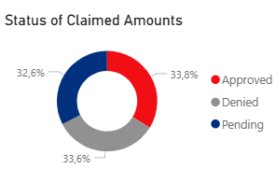
Claim Status Distribution Overview
Claim Status Categories
  Claims are categorized into approved, denied, and pending, representing distinct processing stages.
Pending Claims Insight
  32,6% pending claims segment highlights potential workflow inefficiencies or need for additional review.
Denied Claims Implications
  High denial rates of 33,6 % may signal issues with documentation or submission errors.
Operational Improvements
  Optimising processes can reduce pending and denied claims, improving efficiency and customer satisfaction.

Slide 7
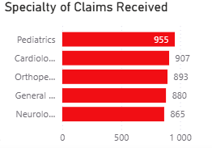
Specialty Claims Insight
High Claim Volume Specialties
  Pediatrics, Cardiology, and Orthopedics generate the highest claim amounts, indicating key cost drivers.
Broader Specialty Contributions
  General practice and Neurology also contribute significantly to claims, reflecting diverse healthcare needs.
Notes:
This slide highlights the volume of claims originating from different medical specialties, revealing important insights about service utilization patterns. Pediatrics leads with the highest number of claims, followed closely by Cardiology and Orthopedics. These three specialties combined represent a significant share of the insurer’s claim activity, signaling that families with children, individuals requiring heart-related treatments, and patients with musculoskeletal conditions are core cost drivers within the portfolio. General practice and Neurology also show substantial contributions, reflecting broad usage across primary care and neurological treatments. These trends can inform targeted initiatives such as disease management programs, improved coverage plans, provider engagement strategies, or negotiation of treatment costs in high-utilization fields. Understanding specialty-level claim behavior assists insurers in anticipating healthcare demands, managing risk exposure, and developing evidence-based benefit designs that align coverage with population health needs.

Slide 8
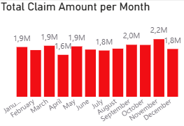
Monthly Claim Patterns
Seasonal Claim Variations
  Claim amounts fluctuate due to seasonal illness cycles and scheduled medical procedures throughout the year.
Operational Planning Benefits
  Understanding monthly claim peaks enables better resource allocation and improves claims processing efficiency.

Slide 9
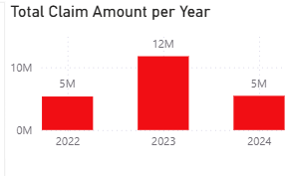
Yearly Claim Trends
Stable Claim Amounts
  Claim amounts in 2022 and 2024 remain steady at around 5 million, indicating consistent activity levels.
Spike in 2023 Claims
  2023 shows a significant spike exceeding 12 million, suggesting unusual factors impacting claims that year.
Analysing Underlying Causes
  Assessment of healthcare usage, demographics, and external health events can explain the 2023 spike.
Notes:
.

Slide 10
Demographic and Behavioral Insights
stage 2

Slide 11
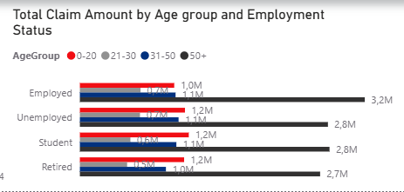
Claims by Age Group and Employment Status
High Claims Among Employed
  Employed individuals show the highest claim amounts across all age groups due to active insurance and comprehensive coverage.
Significant Claims in 50+ Age Group
  The 50+ employed age group has high claims driven by chronic conditions and health needs.
Increased Claims in Retired Individuals
  Retired individuals over 50 show higher claim amounts due to age-related medical care.
Lower Claims Among Students and Unemployed
  Students and unemployed people contribute fewer claims likely due to limited insurance coverage or healthcare use.

Slide 12
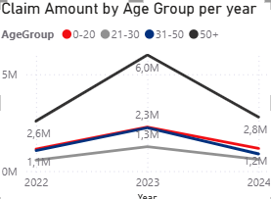
Claim Amount by Age Group per Year
High-Impact 50+ Age Group
  The 50+ age group drives the highest claim amounts due to chronic disease healthcare needs.
Rising Claims in 0-20+ Age Group
  Claims increase steadily in the 0-20 group
Lower Claims in Younger Groups
  The 21-30 and 31-50 age groups have fewer claims

Slide 13
Operational and Strategic Recommendations
stage 3

Slide 14

Key Recommendations
Target High-Volume Specialties
Focus on Pediatrics, Cardiology, and Orthopedics for cost and utilization analysis to improve care and optimize benefits.
Plan for Seasonal Variations
Prepare for peak claim periods by enhancing staffing, streamlining workflows, and supporting technology use.
Reduce Pending and Denied Claims
Use automation, clearer documentation guidelines, and eligibility tools to decrease pending and denied claim outcomes.
Investigate 2023 Claim Spike
Conduct focused analysis on the 2023 claims increase to identify causes like health events or policy changes.
Targeted Wellness Initiatives
Develop wellness and chronic disease programs for high-claim demographics aged 0-20 and 50+ to manage long-term risk.
Notes:
.

Slide 15

Mathabathe Paballo phakoe

